Slide 1
How To Start The Change For A DevOps Team In A Large Enterprise
Managing Director I CISO On Demand I CyberFeminist I CISSP I PhD
Responsible Cyber Pte. Ltd. I Secucial Pte. Ltd.
@m49D4ch3lly
ALL RIGHTS RESERVED

Slide 2




My Career So Far ….
Failing modelling career / Ongoing PhD
IT/Security Consultant & Trainer
Chief Information Security Officer On Demand
CyberFeminist Hacker
& Influencer
(A lot of photoshop…)

Slide 3
Why DevSecOps or Security Now ?

Slide 4


Slide 5
We are Changing the Way We Live and The Way We Do Business …
New Technologies → New Risks

Slide 6
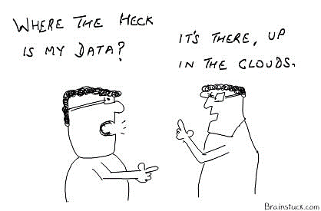

Slide 7
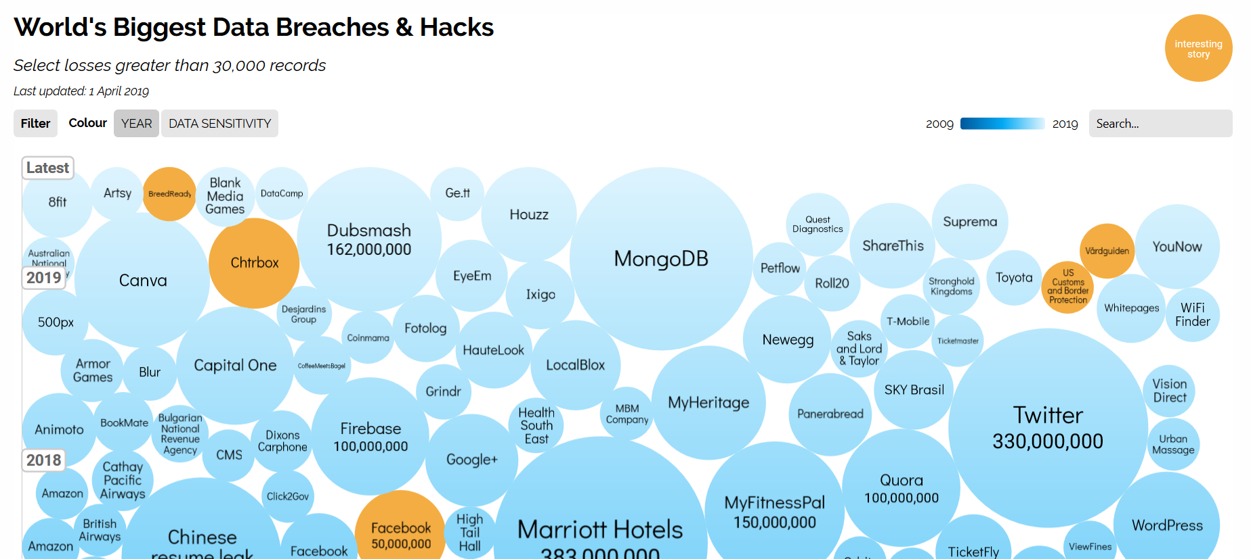
https://informationisbeautiful.net/visualizations/worlds-biggest-data-breaches-hacks/

Slide 8

What is the Cloud ?

Slide 9
CLOUD
A Shared-Responsibility

Slide 10
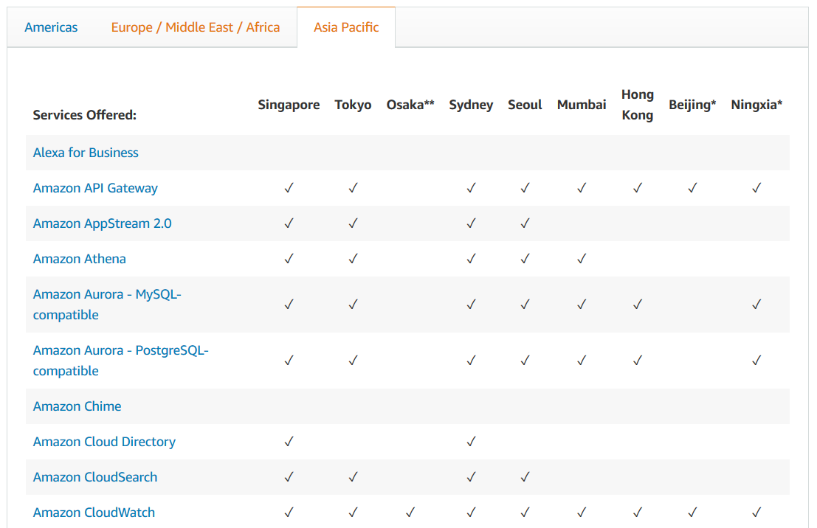

Slide 11
Risks Demystification
Infrastructure/Security
Employees
Service Level Agreements
Data Protection, Access and Location
Business Alignment and Support
Vendor Relationship Management

Slide 12
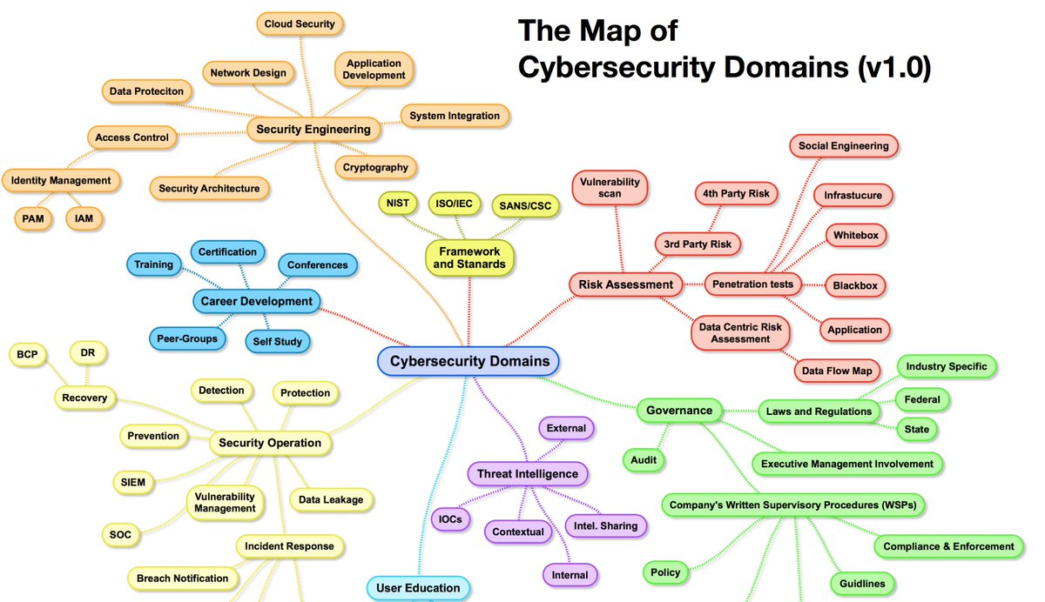

The Problem
Where to Start

Slide 13
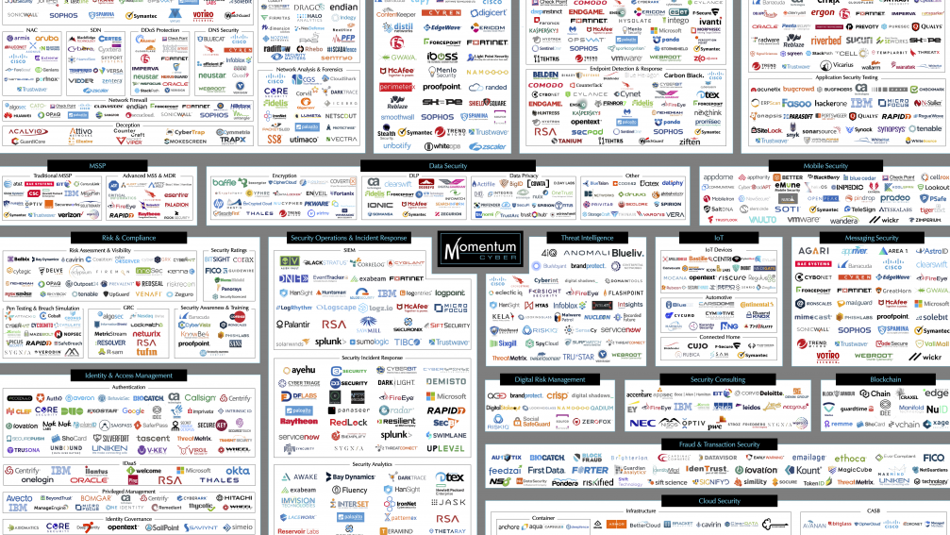
The Problem
What to Choose

Slide 14


Slide 15
DevSec .. What ?

Slide 16
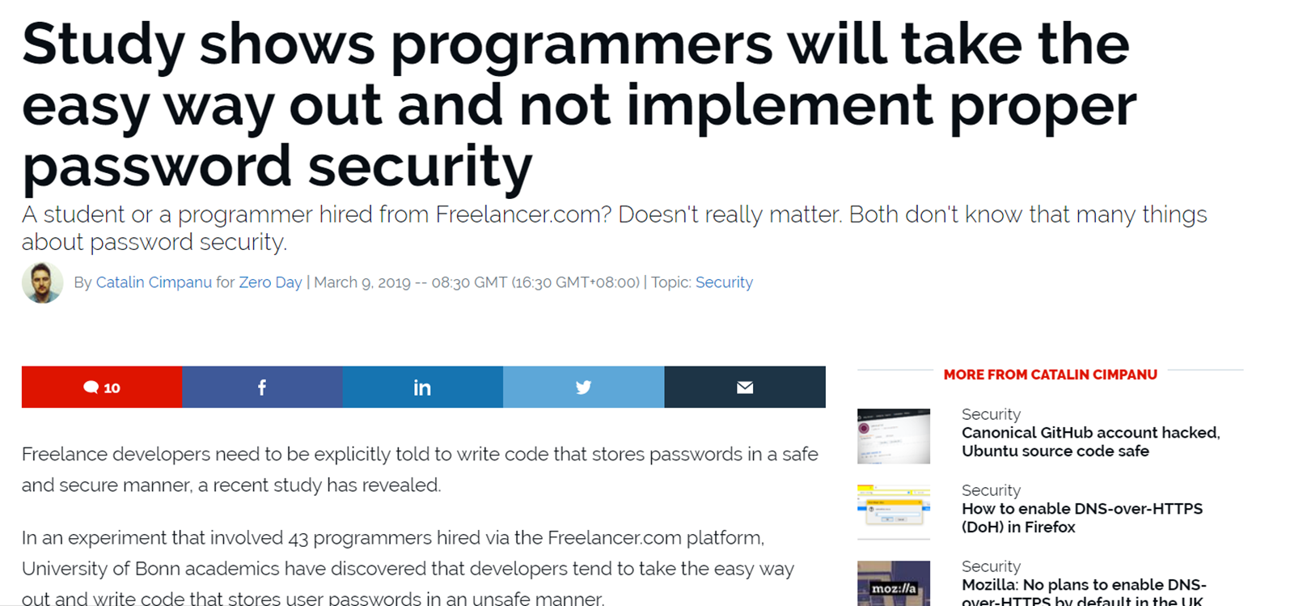

Slide 17
Perhaps Start at The Beginning ?

Slide 18


Slide 19
Build a Community … and Make Your Teams Own Security
Empower your teams to own security and get good at it

Slide 20
Perhaps with Some Training?
Rely on continuous learning instead of an end-of-phase approach

Slide 21
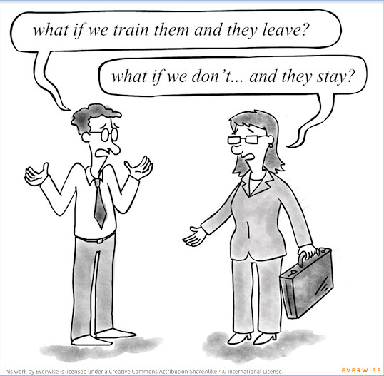
That Simple, Yes….

Slide 22
So, now How to Do It ?
Emphasize culture change over policy enforcement

Slide 23


Slide 24






Moved to Singapore, Asia
Moved to Qatar, Middle-East
Love fast cars
& salsa
Born in Krakow, Poland, EU
Moved to Tunisia, North-Africa at age 7
Moved to Paris, France

Slide 25
Culture ? What ?

Slide 26


Slide 27
DevSecOps is the philosophy of integrating security practices within the DevOps process. DevSecOps involves creating a 'Security as Code' culture with ongoing, flexible collaboration between release engineers and security teams.
Source: https://www.sumologic.com/insight/devsecops-rugged-devops/

Slide 28

Of the secure password storage systems developers chose to implement for this study, only the last two, PBKDF2 and Bcrypt, are considered secure.
8 - Base64 10 - MD5 1 - SHA-1 3 - 3DES 3 - AES 5 - SHA-256 1 - HMAC/SHA1 5 - PBKDF2 7 - Bcrypt
Remember the Study ?

Slide 29


Slide 30

Strategical Steps
It Starts at the Top
Focus on a Few Critical Shifts
Use Existing Good Practices for Your Advantage
Integrate Formal & Informal Process
Measure the Change

Slide 31
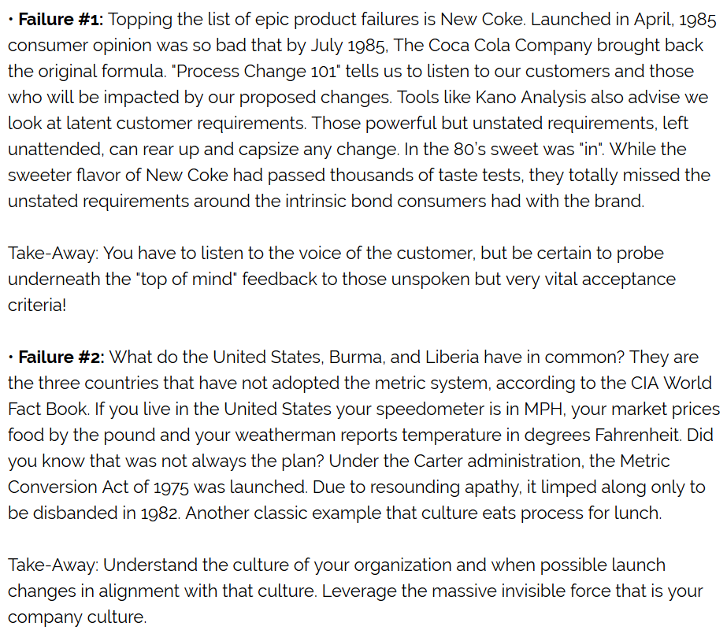
Epic Failures
Source: https://www.processexcellencenetwork.com/lean-six-sigma-business-performance/columns/three-epic-change-failures-and-what-we-can-learn-f

Slide 32


Slide 33

Takeaways
Next week you should:
Identify someone who is passionate about the topic
In the first three months, you should:
Engage with the teams and build transparent communications
Identify the team that wants to add security and embrace DevSecOps
Define security practices that could represent quick wins
Within six months you should:
Build some metrics
Identify DevSecOps champions per teams and define rewards
Celebrate early successes

Slide 34
Thank You Very Much
Remember; Cyber Security Starts With You – People !

Slide 35

Contact
Magda Lilia CHELLY
Managing Director | Cyber-Security Evangelist
Doctor in Telecommunication Engineering
Responsible Cyber Pte. Ltd. | Co. Reg No: 201616321C
mchelly@responsible-cyber.com
www.responsible-cyber.com

